Slide 1


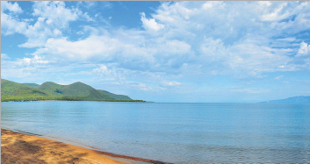
The UNDP-GEF Project "Integrated Natural Resource Management in the Baikal Basin Transboundary Ecosystem” Achievements in 2012-2015
Sergey Kudelya
The Project Manager
http://baikal.iwlearn.org/

Slide 2
Project Summary
96 activities were under implementation.
The project took part in 124 events.
Moreover 230 media sources have published information about project activities.
2012 year budget of the Project was realized by 95 %.
2013 year budget of the Project was realized by 99 %.
2014 year budget of the Project was realized by 96 %.
2015 year budget of the Project was realized by 56 %.
The Project web-site works in Russian, Mongolian and English.

Slide 3
Total 2011-2015 expenditure
Project Outcomes |  | Total budget (USD) | Expenditure 2011+2012 | Expenditure 2013 | Expenditure 2014 | Expenditure 2015 – by now | Budget balance
Outcome 1: Strategic policy and planning framework
 | $ 917 930.00 |  | $ 486 312.97 | $ 292 882.27 | $ 109 496.91 | $ 26 445.32 | $ 2 792.53
Outcome 2: Institutional Strengthening for IWRM.
 | $ 751 534.00 |  | $ 242 852.27 | $ 218 659.92 | $ 157 992.46 | $ 71 123.39 | $ 60 905.96
Outcome 3: Demonstrating methods and approaches for water quality and biodiversity mainstreaming.
 | $1 844 174.00 |  | $ 202 329.09 | $ 517 112.47 | $ 600 762.1 | $ 296 207.51 | $ 227 762.83
Project Management
 | $ 384 362.00 |  | $ 102 990.12 | $ 98 744.84 | $ 112 877.85 | $ 26 671.12 | $ 43 078.07
TOTAL | $3 898 000.00 |  | $1 034 484.45 | $1 127 399.5 | $ 981 129.32 | $ 420 447.34 | $ 334 539.39

Slide 4
Outcome 1: Strategic policy and planning framework.
Output 1.1. Transboundary Diagnostic Analysis of threats to the Baikal Basin ecosystem including Khovsgol Lake in Mongolia completed.
Output 1.2. Study on the Selenga Delta habitat and water quality issues, including toxic pollution and nutrient loading, water level fluxes, sedimentation levels, and the health of the benthic zone.
Output 1.3. An assessment of transboundary problems in integrated surface and ground water resources management of the Baikal Basin and corresponding pollution threats, focusing on: stress on ground and surface water resources; deterioration of water quality in both surface and ground waters of the Basin; and vulnerability of groundwater dependent ecosystems.
Output 1.4. Pollution hot spot assessment of the transboundary Baikal Basin, including a prioritized list of projects to be considered for future investment, the development of prefeasibility studies and revised regulations to reduce industrial pollution loading in the Baikal/Selenga basin.
Output 1.5. Strategic Action Programme (SAP), including joint actions to enhance ecosystem protection.
Output 1.6. Biodiversity conservation standards and biodiversity management objectives for tourism (inlcuding sport fishing) and mining integrated in SAP and local legislation, regional development plans; with amendments to EIA policies to address biodiversity risks.
Output 1.7. Sub-basin watershed management plans incorporating biodiversity management and ecosystem resilience objectives.

Slide 5
Компонент 1: Стратегическое планирование для комплексного управления ресурсами бассейна озера Байкал.
Подкомпонент 1.1: завершение Трансграничного Диагностического Анализа (ТДА)
Подкомпонент 1.2: исследование ареала дельты реки Селенга и определения стратегий для устранения рисков качеству воды, включая сбросы стойких токсичных веществ (СТВ) и биогенных веществ
Подкомпонент 1.3: Комплексное управление поверхностными и грунтовыми водами

Slide 6
Компонент 1: Стратегическое планирование для комплексного управления ресурсами бассейна озера Байкал.
Подкомпонент 1.4: Оценка источников загрязнения БОБ
Подкомпонент 1.5: разработка Стратегического Плана Действий (СПД)
Подкомпонент 1.6: формирование стандартов защиты и управления объектами биоразнообразия в туризме (включая спортивную рыбалку) и добывающей промышленности, интегрированной в СПД, местное законодательство и региональные планы развития.
Подкомпонент 1.7: формирование планов управления водосборными суб(под)-бассейнами, входящими в БОБ, с учетом всех аспектов управлении биоразнообразием и гибкости экосистемы.

Slide 7
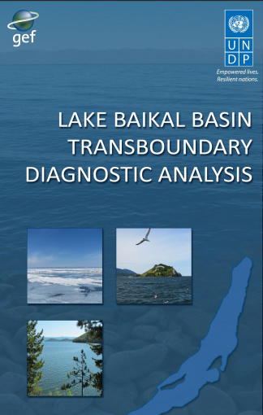
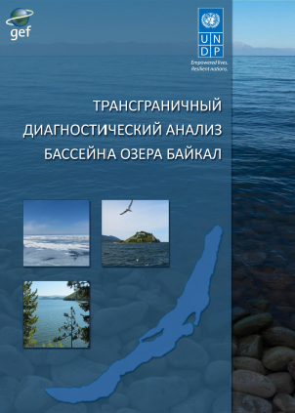
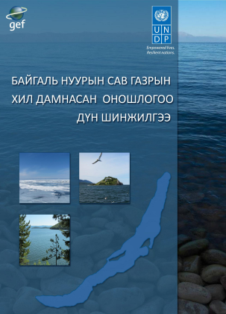
Transboundary Diagnostic Analysis (TDA)
Additionally: Climate Change Assessment, Ground Water Assessment, Hot Spot Assessment for TDA, Study on the Selenga Delta

Slide 8
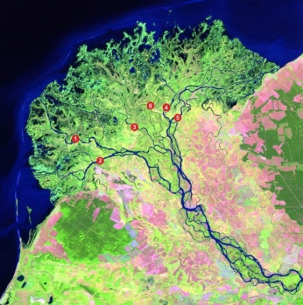
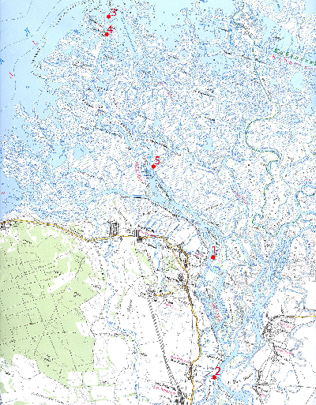
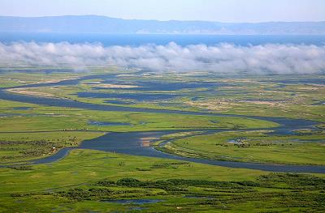
Selenga Delta Monitoring

Slide 9
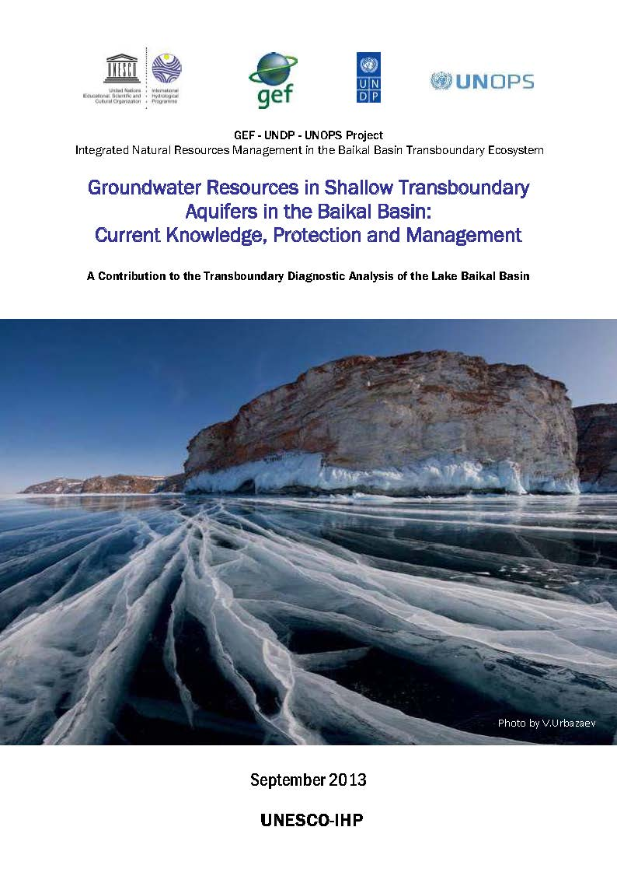
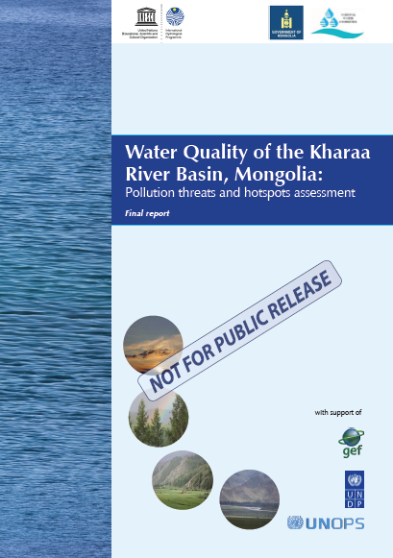
Projects with UNESCO

Slide 10
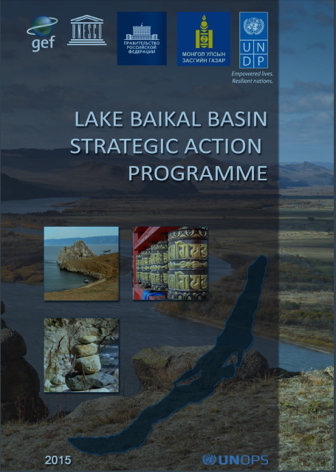
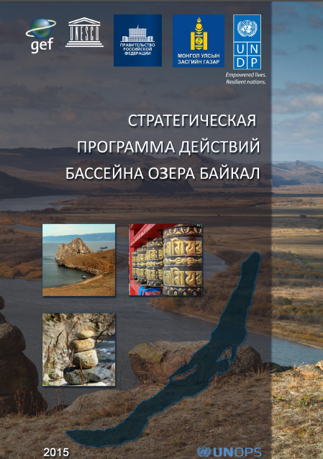
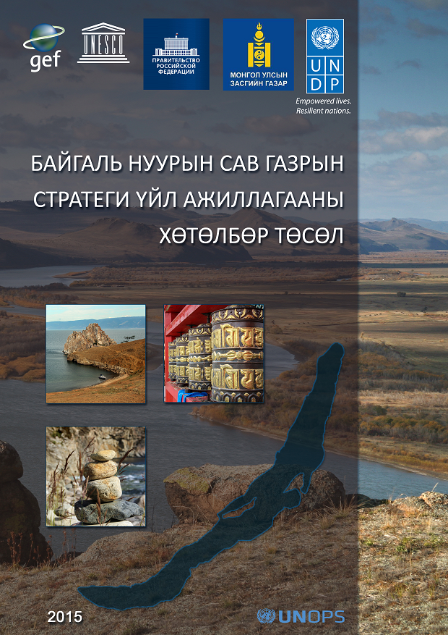
Strategic Action Programme (SAP)

Slide 11
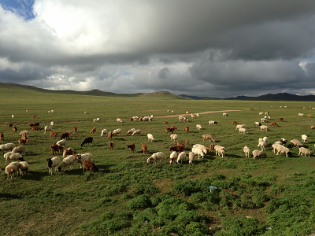
Biodiversity conservation standards and biodiversity management objectives for tourism and mining
Best practice conservation standards for mining using international and regional examples were elaborated.
Gap analysis concerning best practices and the existing policies and standards in mining and tourism sector in Russia and Mongolia was provided.
Recommendations for changes to local and national policies, legislation and regional development plans to enhance biodiversity protection in mining and tourism sector were developed.
Recommendations for EIA process in mining and tourism sector to make it more biodiversity relevant and focused were developed.
Ecotourism and pollution avoidance aspects for tourism plans in the region, especially those being developed in Irkutsk and Buryatia were studied.

Slide 12
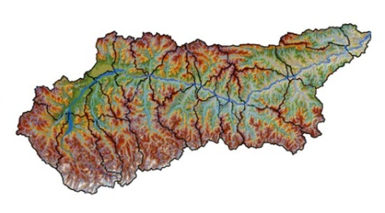
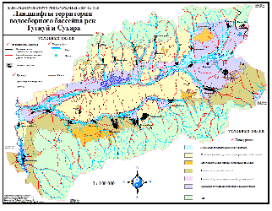
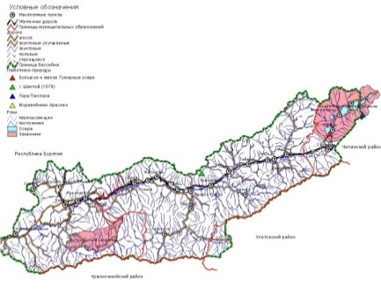
Sub-basin management plans
Ider River sub-basin
(Mongolia)
Tugnuy-Sukhara sub-basin
(Buryatia, Russia)
Eg­­ River sub-basin
(Mongolia)
Khilok sub-basin
(Zabaikalsky Krai, Russia)

Slide 13
Outcome 2: Institutional Strengthening for IWRM .
Output 1.1. Joint Commission for the Baikal / Selenga Basin established and capacitated on the basis of the current joint Russian - Mongolian Task Force on Transboundary Water Use and Protection.
Output 1.2. Inter-ministerial committees established at national levels.
Output 1.3. Training program developed and implemented for key actors in an improved and enhanced, long-term transboundary management of the Baikal Basin.
Output 1.4. The harmonized Baikal Basin Water Quality Monitoring program set under implementation, including upgraded monitoring stations .

Slide 14
Компонент 2: Институциональное укрепление для комплексного управления водными ресурсами.
Подкомпонент 2.1: Создание Совместной Комиссии по бассейну Байкала/Селенги на базе уже существующего российско-монгольского трансграничного сотрудничества.
Подкомпонент 2.2: Создание межминистерских комитетов.
Подкомпонент 2.3: Разработка обучающих программ по ключевым вопросам долгосрочного трансграничного управление БОБ.
Подкомпонент 2.4: Гармонизация программ мониторинга качества воды в Байкале с учетом обновленных станций мониторинга.

Slide 15
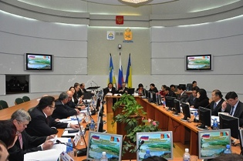
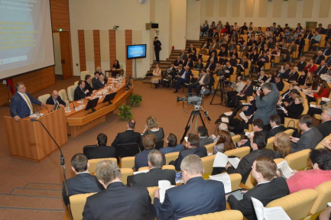
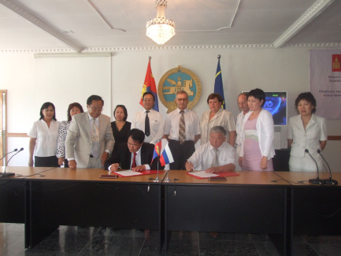
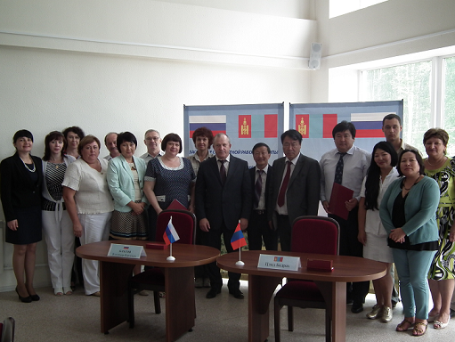
Enhancement of the legal and institutional framework of bilateral transboundary water cooperation between Russia and Mongolia

Slide 16
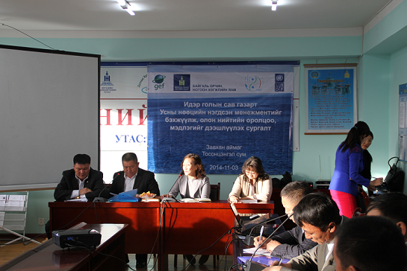
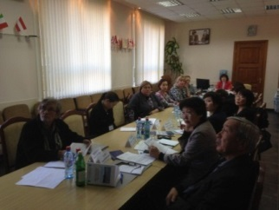
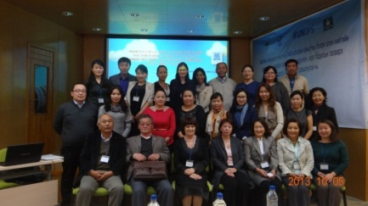
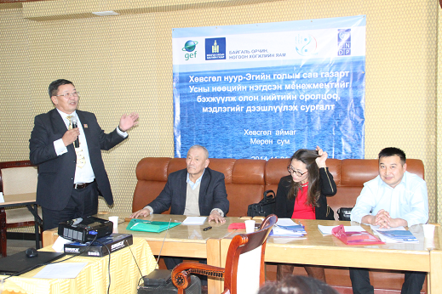
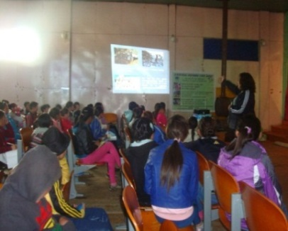
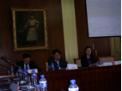
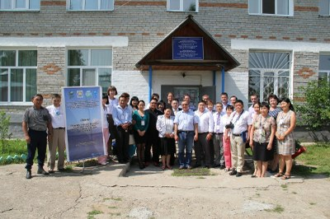
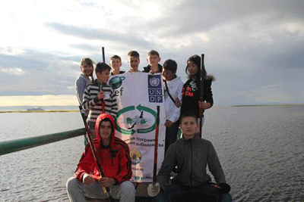

Training programs
In total 224 people trained:
- Buryat regional authorities: 40 people.
- Mongolia local authorities (Eg and Ider): 20 people.
- PA of Russian Baikal: 50 people from 5 PA.
- Ministry of Natural Resources (Russia): 40 people.
- Ministry of Environment and Green Development - 20 people.
- Hydrochemical laboratory (Mongolia) - 4 people.
- School teachers - 50 people.

Slide 17
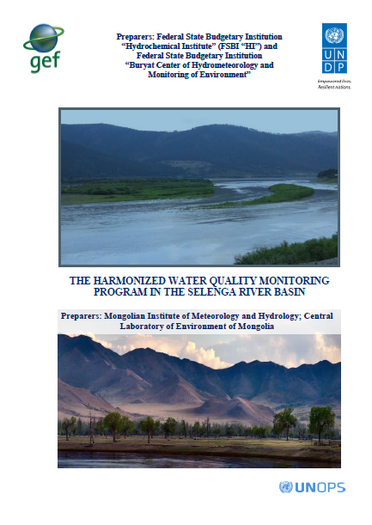
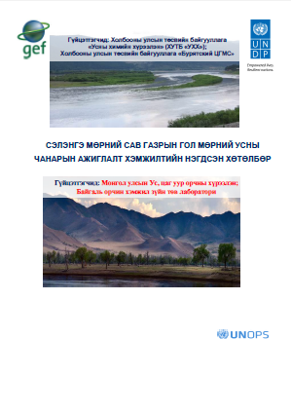
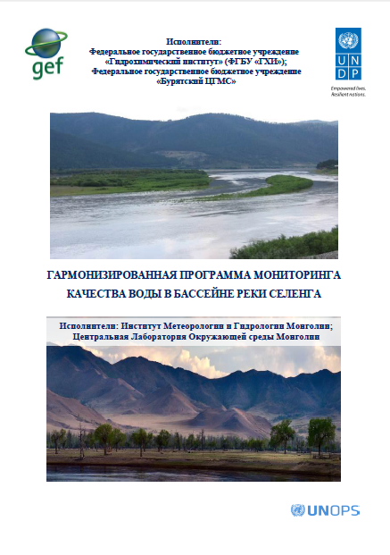
The harmonized water quality monitoring program for the Selenga River basin

Slide 18
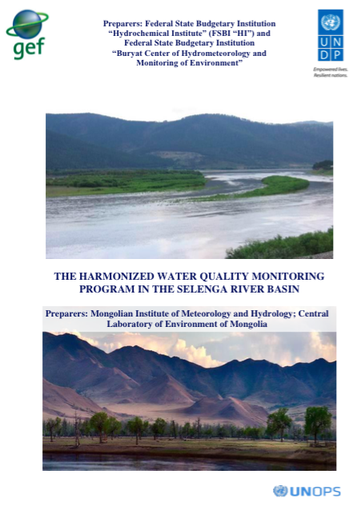
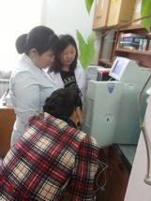
The harmonized water quality monitoring program for the Selenga River basin

Slide 19

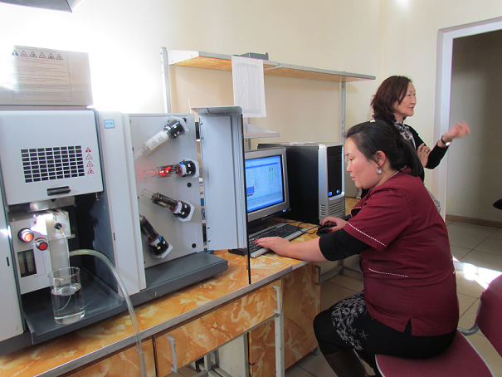

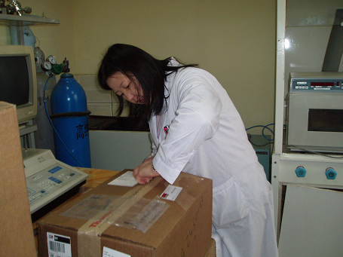
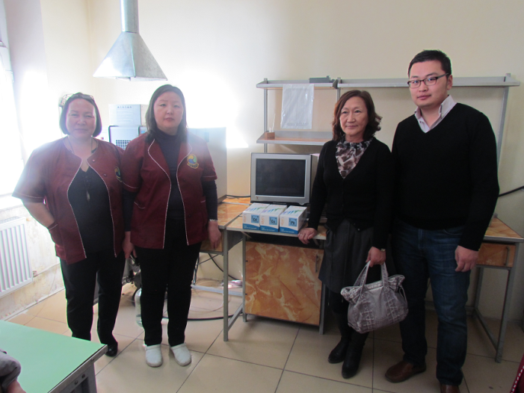
The intercalibration exercise for the harmonized water quality monitoring program for the Selenga River basin

Slide 20
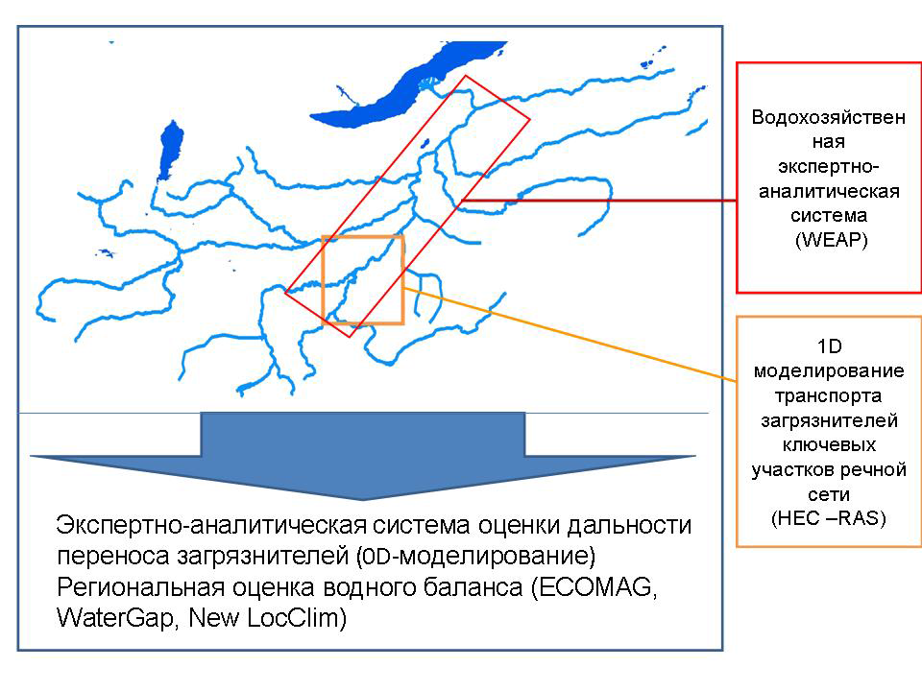
The models of pollutants transport and water balance

Slide 21
Outcome 3: Demonstrating methods and approaches for water quality and biodiversity mainstreaming.
Output 1.1. Pilot projects on biodiversity conscious mining approaches.
Output 1.2. Demonstration and strategy development for (dead) livestock disposal to cease periodic anthrax outbreaks.
Output 1.3. Pilots for the mainstreaming of biodiversity and ecosystem health management objectives into tourism planning and practice.
Output 1.4. The harmonized Baikal Basin Water Quality Monitoring program set under implementation, including upgraded monitoring stations .

Slide 22
Компонент 3: Демонстрация методов и подходов улучшения качества водных ресурсов и защиты объектов биоразнообразия.
Подкомпонент 3.1:Пилотные проекты в горнодобывающей отрасли, учитывающие принципы сохранения биоразнообразия.
Подкомпонент 3.2: Стратегия управления скотомогильниками для предотвращения периодических вспышек сибирской язвы.
Подкомпонент 3.3: Пилотные проекты в различных областях, учитывающие принципы сохранения биоразнообразия.
Подкомпонент 3.4: Создание Байкальского информационного центра и форума для взаимодействия неправительственных организаций.

Slide 23
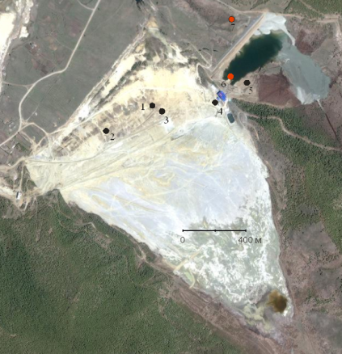
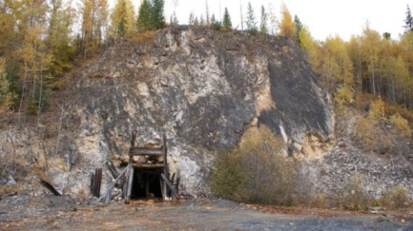
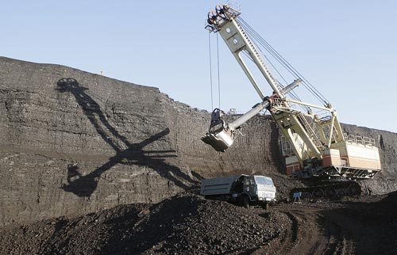
Pilot projects on biodiversity conscious mining approaches
mining plant “Dzhidinsky”
poly-metal deposit “Kholodninsky ”
gold mine “Holbinsky”
coal mine “Nikolsky”

Slide 24
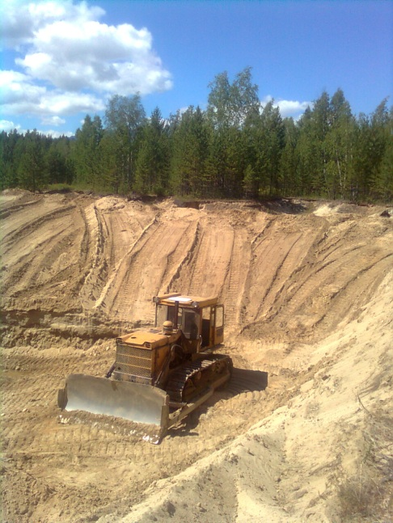
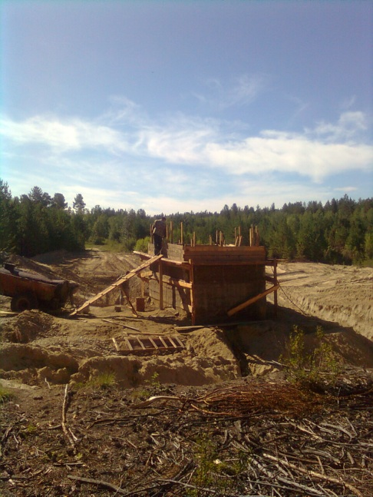
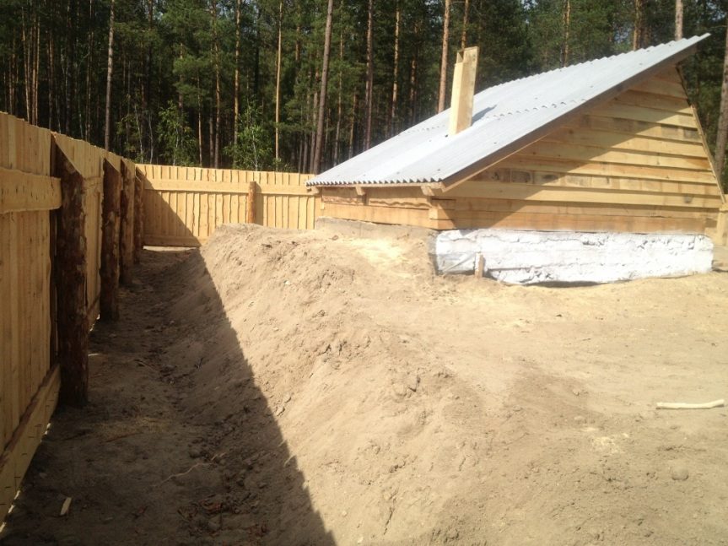
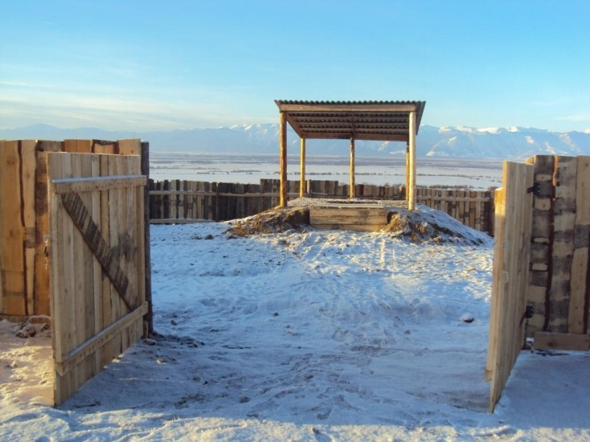
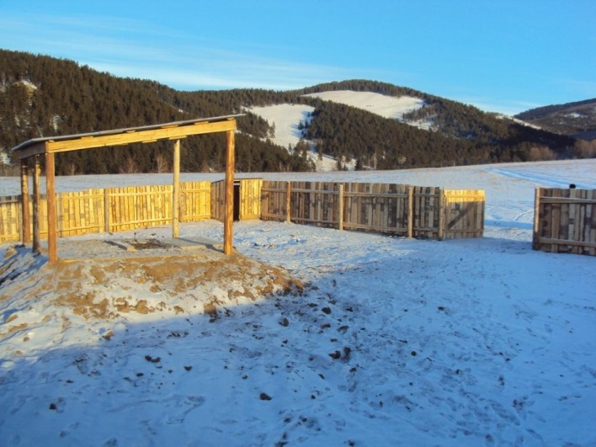
Cattle mortuaries in Kurumkansky and Barguzinsky district of the Republic of Buryatia
strategy for (dead) livestock disposal;
cattle mortuaries construction;
satellite analysis and identification of abandoned cattle mortuaries.

Slide 25
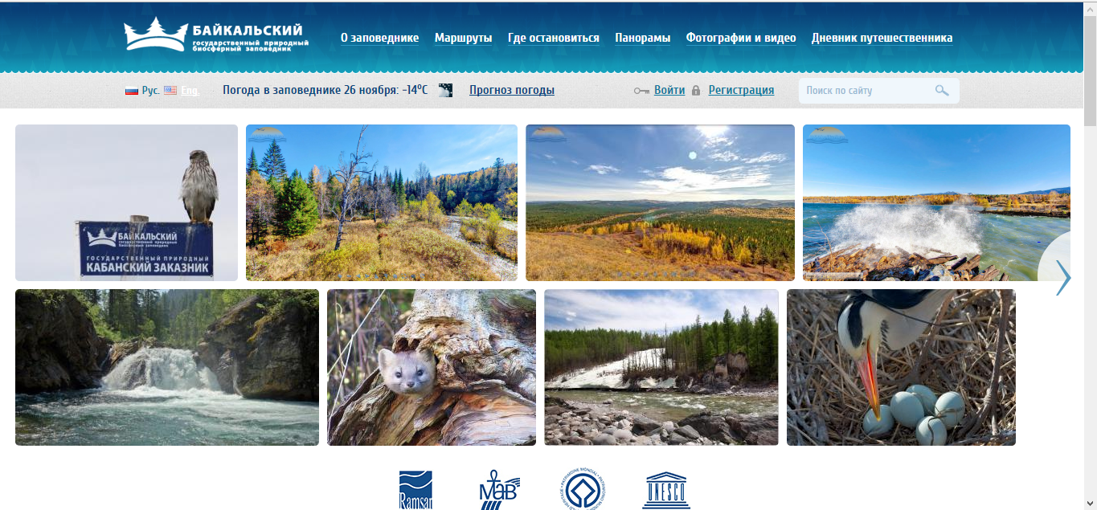
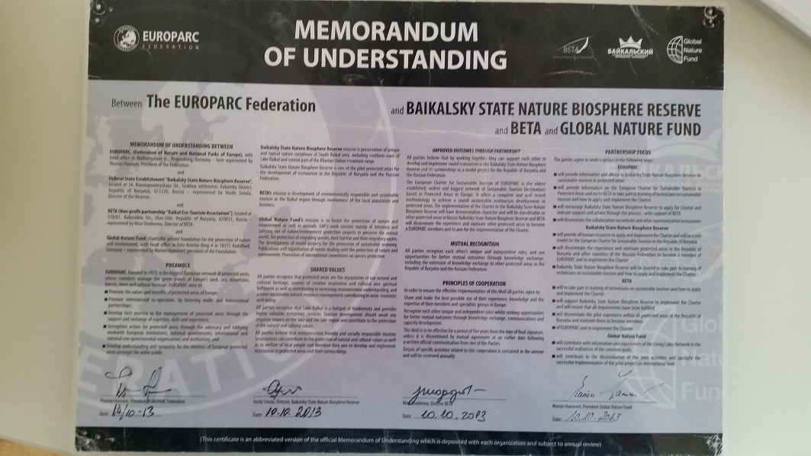
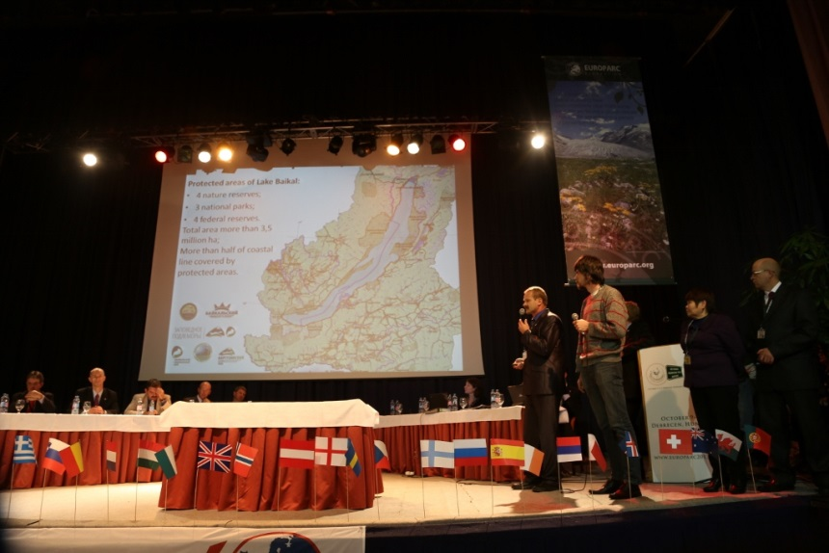
Baikal State Nature Biosphere Reserve – EUROPARC integration

Slide 26
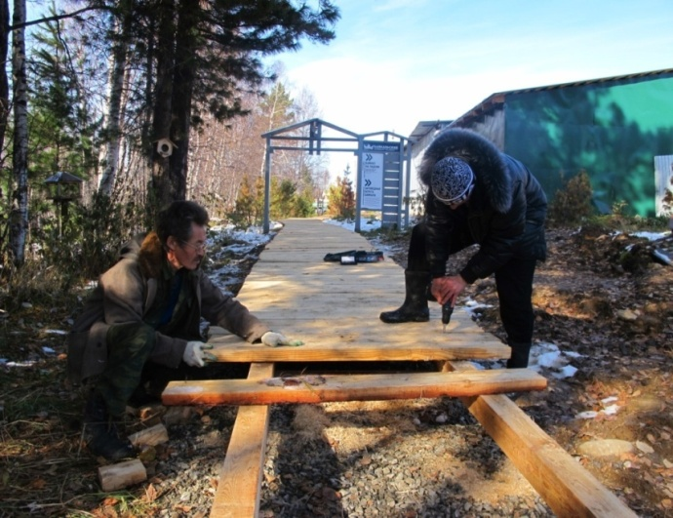
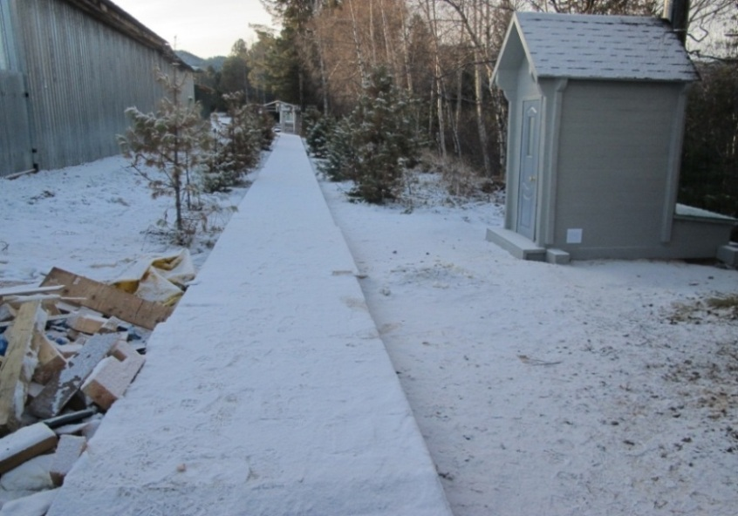


Baikal State Nature Biosphere Reserve – eco-trail “Cedar Alley”, treatment facilities

Slide 27





Zabaikalsky national park –
Observation of the Baikal seal on the Ushkanii islands
before
after

Slide 28



Zabaikalsky national park -
Eco-camp in the Sorozhya bay

Slide 29



Pribaikalsky national park –
Observation platforms on Hoboi cape,
Reservation zone for Khankhoiskaya bank

Slide 30



Eco-trail Yangima

Slide 31






Small grants, shoreline cleanup campaigns

Slide 32




Precious Necklace of Baikal

Slide 33




The Baikal Information Center (BIC)

Slide 34


The Baikal Information Center
- The Biannual State of the Environment Report for the Baikal Basin

Slide 35



The Baikal Information Center
- The Ecological Atlas of the Baikal Basin
> 150 карт на английском, монгольском и русском

Slide 36

The Baikal Information Center
- The Ecological Atlas of the Baikal Basin
- Geographical map server- http://geonode.iwlearn.org/

Slide 37




Baikal treasure learning kit presentation in Mongolia

Slide 38


Journey into the world of water" in the "National Museum of the Republic of Buryatia".

Slide 39







The HD documentaries “Baikal without boundaries”, “Leman-Baikal” (Russia and Mongolia)
TV channels and festivals

Slide 40


Results on the web
http://baikal.iwlearn.org/ru/rezultaty

Slide 41
Thanks for you attention.
http://baikal.iwlearn.org

